Slide 1
Data Share
Stable Sites, Standardized Sites
Public
Showroom
Content
Server
Model and Logic Share
Public
Browsers
Public
Browser Download
Rules and Models
Model and Logic Share
Publish
Data Eval & Gather
Private
Browsers for Members
Content
Server
Model and Logic Eval & Gather
Exploration and Experiments
Private Tools and Workspaces
Private
Browser Download
Model and Logic Eval & Share

Slide 2
My BTTW to run surveys, Write gathering software, Experiment with Algorithms, Write things for the web site. I plan to write “live” models of things, I would build them
offline on my machine and post them to the public area. You could experiment with sending
Commands to it remotely to run surveys and gather data and do big data things.
Publish
Data Eval & Gather
Content
Server
Model and Logic Eval & Gather
Exploration and Experiments
BTTW Machine with Tools and Workspaces and Devices
Model and Logic Eval & Share
Sensor
Interface Machine
Python, Sh Scripts, Device Manager, File Manager, Model Manager

Slide 3
This is the thin VPN interface to the public site. It is database and form driven. It replaces current HTML
and requires users to download a special purpose browser that only works with this kind of site. It is aimed
scientific and technical groups and large groups generally. The common denominator for the groups is they are
are large (10k to 10M) and they all have things to contribute. This is only the Public Area they use to share with
everyone. There is a Private Area made up of all their individual BTTW machines. A global private VPN
Data Share
Stable Sites, Standardized Sites
Public
Showroom
Content
Server
Model and Logic Share
Public
Browsers
Public
Browser Download
Rules and Models
Model and Logic Share
Publish

Slide 4
Internet Foundation Review – PDF, WHO, Covid-19
PDF Association Tool to convert PDF to Excel
World Health Organizations Critical Situation Reports in PDF
Comments and Recommendations for:
Online PDFA Tool
WHO Table Processors and Extractors
WHO Table Data Compilers and Curators
WHO Table Data Analysis Program Groups
WHO Table Data Sources
World
Global Communities
Global Communities Data Source
PDF
PDFA
WHO
Tables and Data
Tsv, Excel, Sheet, DB
Algorithms
Models
Extract

Slide 5
Infectious
NotInfectious
Infected
UnInfected
Population
Exposed
UnExposed
Infectious Recorded
NotInfectious
Recorded
Infected Recorded
NotInfected Recorded
Recorded
Exposed
Recorded
NotExposed Recorded
Infectious NotRecorded
NotInfectious
NotRecorded
Infected NotRecorded
UnInfected NotRecorded
NotRecorded
Exposed NotRecorded
NotExposed NotRecorded
Infectious
Recovered
NotInfectious
Recovered
Infected
Recovered
NotInfected
Recovered
Recovered
Exposed Recovered
UnExposed
Recovered
Infectious
NotRecovered
NotInfectious
NotRecovered
Infected
NotRecovered
NotInfected
NotRecovered
NotRecovered
Exposed NotRecovered
NotExposed
NotRecovered
Infectious Tested
NotInfectious
Tested
Infected Tested
NotInfected Tested
Tested
Exposed Tested
NotExposed
Tested
Infectious NotTested
NotInfectious
NotTested
Infected NotTested
NotInfected NotTested
NotTested
Exposed NotTested
NotExposed
NotTested
Infectious Testable
NotInfectious
Testable
Infected Testable
NotInfected Testable
Testable
Exposed Testable
NotExposed
Testable
Infectious NotTestable
NotInfectious
NotTestable
Infected NotTestable
NotInfected NotTestable
NotTestable
Exposed NotTestable
NotExposed
NotTestable
Past Present Future
Infected Infecting ToInfect
Infectabled Infectable ToInfectable
Recorded Recording ToRecord
Exposed Exposing ToExpose
Detected Detecting ToDetect
Tested Testing ToTest
Recovered Recovering ToRecovere

Slide 6
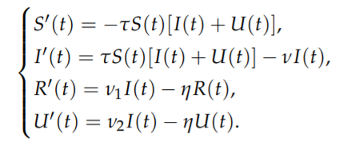
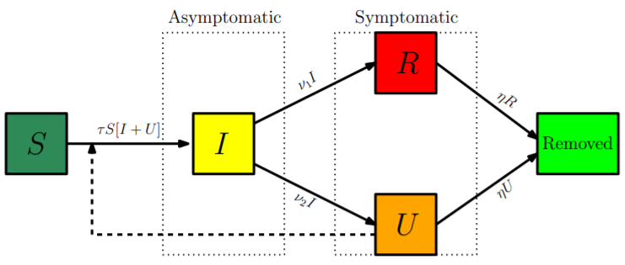
Infectious
Human
Infectable
Virus
Bacteria
Poisin
Prion
Human
Virus
Infected
Measure
Test
Detect
Hear
See
Data
Record
No Data
No Record
Report
Data
Death
Birth
No Report
Symptoms
Seen
UnSeen
No Symptoms
Human
Virus
Symptoms
No Symptoms
Human
Virus
Death
Birth
Human
Virus
Moved In
Report
Human
Virus
Human
Moved Out
Moved Out
Death
Virus
Recovered
No Report
Human
Virus
Human
Virus
Human
Virus
Virus
Human
Virus
Human
Virus
Human
Virus
Human
Human
Virus
Human
Virus

Slide 7
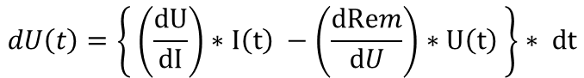
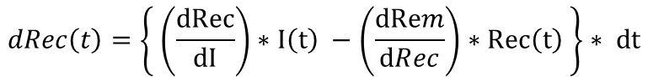
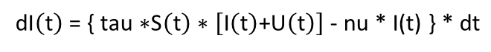

P$op=NeverExposed+Exposed+UnknownExposure$
Susceptilble
$\text{Exposed}\text{ = }\text{Sick}\text{ + }\text{Died}\text{ + }\text{UnTreated}$+ Left + Cured
Infected
$$dS\left(t\right)=\left\{−tau∗S\left(t\right) ∗ \left[I\left(t\right)+U\left(t\right)\right]\right\}∗dt$$
Recorded
d$\text{I}\left(\text{t}\right)\text{ = \{ }\text{tau}\text{ ∗}\text{S}\left(\text{t}\right)\text{ ∗ }\left[\text{I}\left(\text{t}\right)\text{+}\text{U}\left(\text{t}\right)\right]\text{ − }\text{nu}\text{ ∗ }\text{I}\text{(}\text{t}\text{) \} ∗ }\text{dt}$
UnRecorded
$$dRec\left(t\right)=\left\{ \left(\frac{dRec}{dI}\right)∗I\left(t\right) −\left(\frac{dRem}{dRec}\right)∗Rec\left(t\right) \right\}∗ dt$$
Human
Virus
Data
No Data
$$dU\left(t\right)=\left\{ \left(\frac{dU}{dI}\right)∗I\left(t\right) −\left(\frac{dRem}{dU}\right)∗U\left(t\right) \right\}∗ dt$$
Human
Never Exposed
Travelers
Virus
Immigration
No Symptoms
Symptoms
Infected Not Shedding
Died
Birth
Infected And Shedding
Human Populations
Left
Death
Emmigration
Virus
Cured

Slide 8
Infected
Shedding No Symptoms
Self Treating
Shedding
Sought Treatment
Never Exposed
Recovered
Infected Not Shedding
Died
Died
Died
Never Exposed
Infected And Shedding
Recovered
Immune = Kills Virus
Recovered
Infected Not Shedding
Self Treating
Infected Not Shedding
No Symptoms
Infected Not Shedding
No Symptoms
Infected And Shedding
Self Treating
Infected And Shedding
No Symptoms
Infected Not Shedding
Sought Treatment
Infected And Shedding
Sought Treatment
Immune = Kills Virus

Slide 9
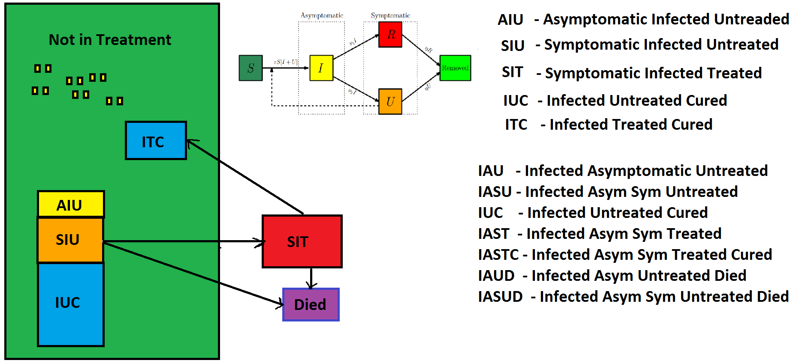

Slide 10
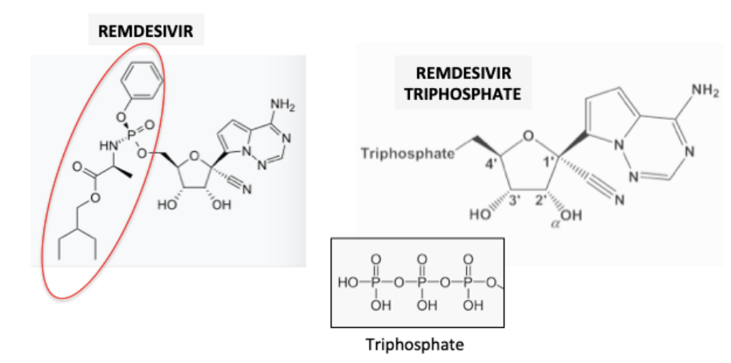
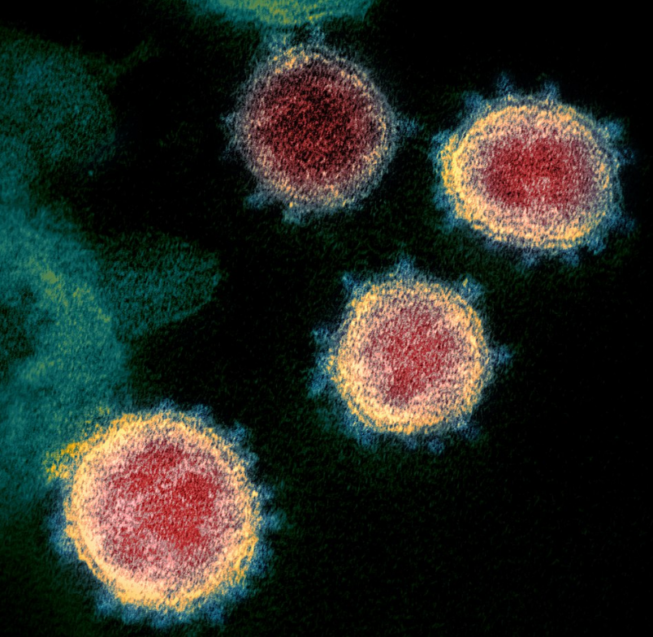
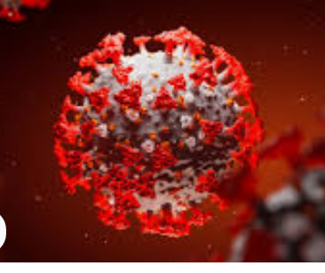
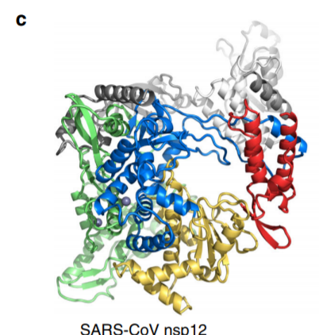
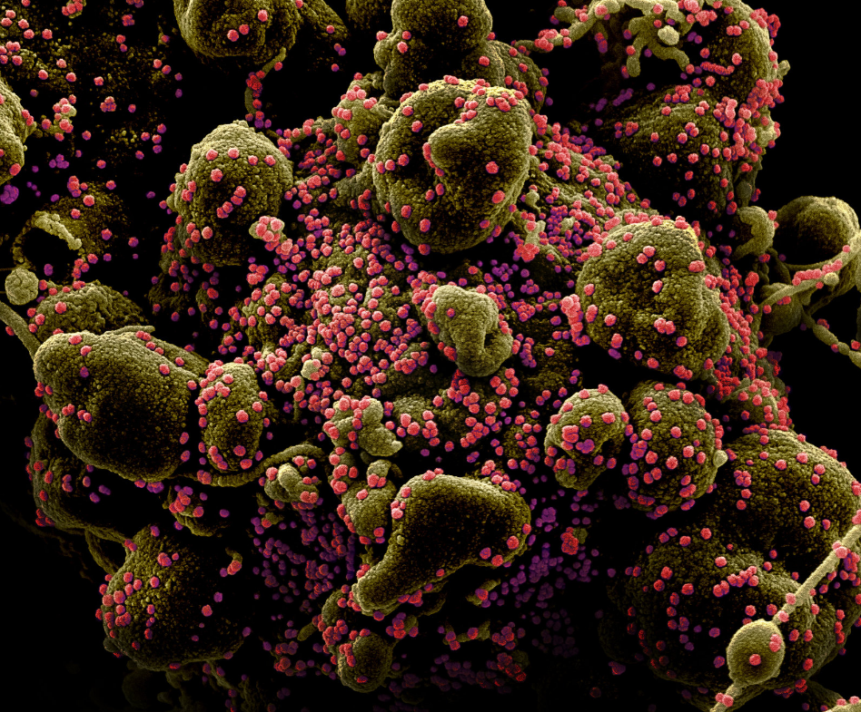
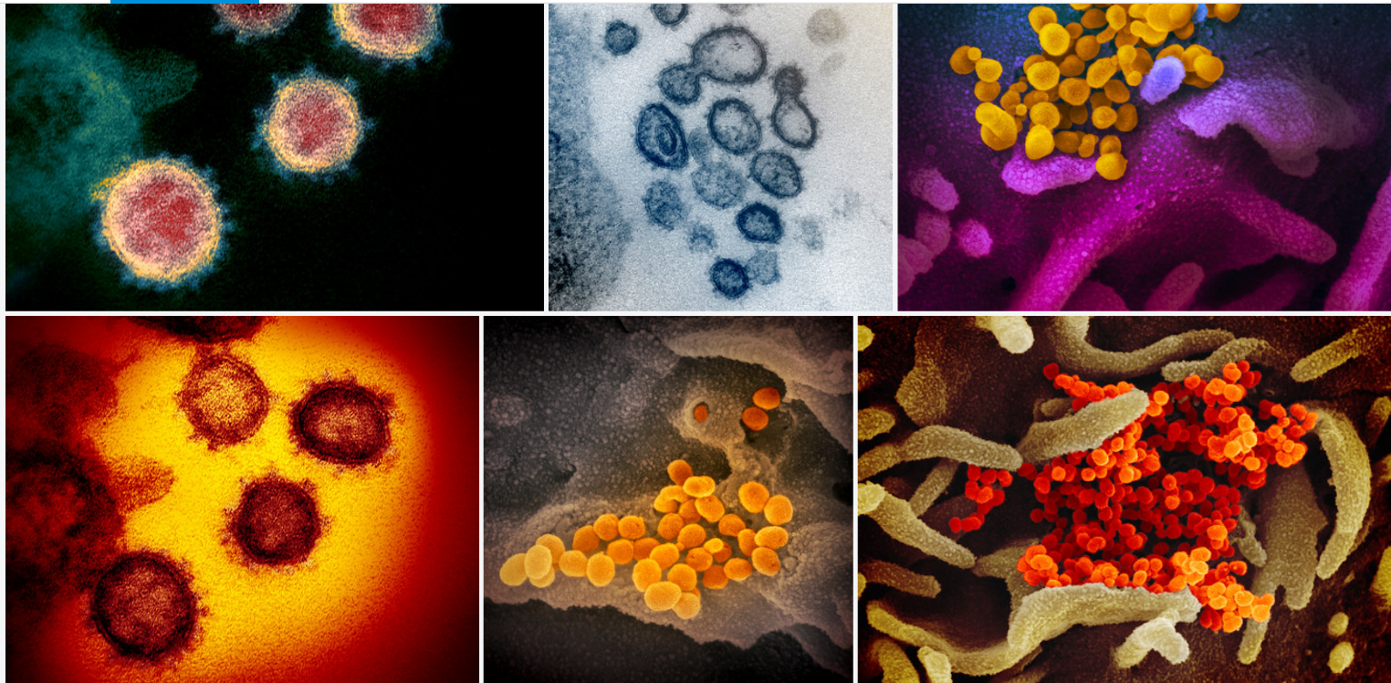
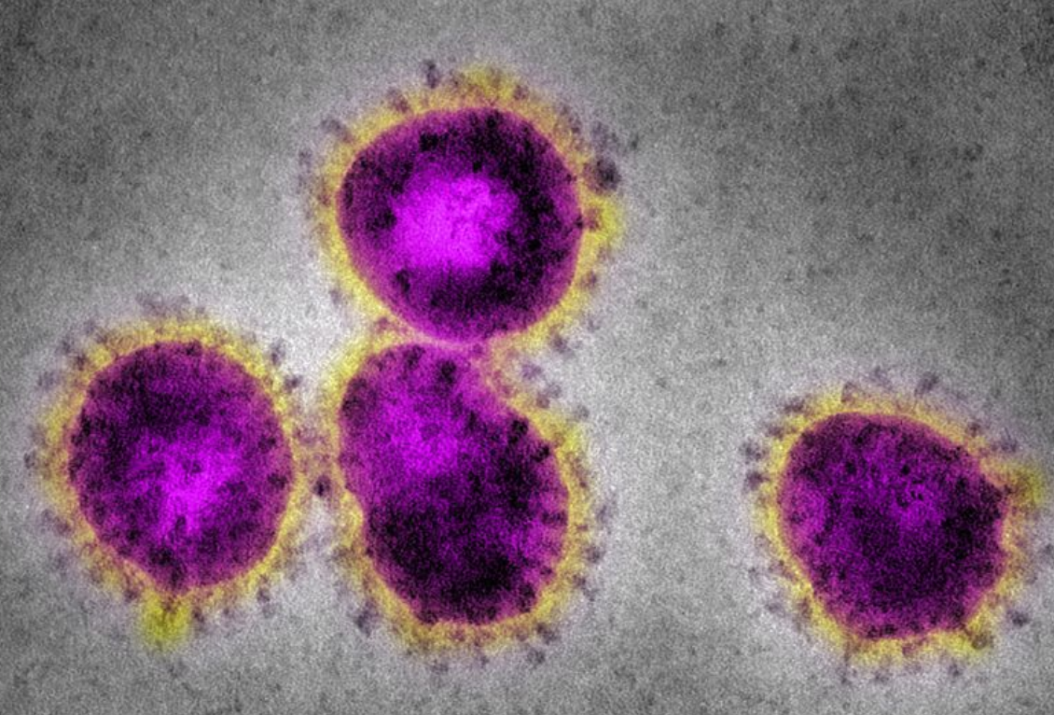
Sir Mike Stratton, Director of the Wellcome Sanger Institute, added: “Samples from substantial numbers of confirmed cases of COVID-19 will be whole genome sequenced

Slide 11
Never Exposed - Susceptible
Any Immune? Active Virus Killers?
At Risk - Vulnerable
New Cities, New Areas, New Countries
New Neighborhoods, New Groups
Priority to: Young, Critical Workers, Old, Infirmed
Poverty, Homelessness, Jobless, No Family, Refugees, Slavery
Recorded
Died
Treated
Tested
Infected Incubating
Infected Asymptomatic
Infected Symptomatic
Infected/ Cured
Asymptomatic
Treated
Infected Incubating
Infected Asymptomatic
Died
Infected Incubating
Infected Asymptomatic
Infected/ Cured
Asymptomatic
Infected Asymptomatic

Slide 12
Infected Incubating
Infected Asymptomatic
Recorded
Died
Infected Incubating
Tested
Treated
Tested
Infected Incubating
Infectious Asymptomatic
Infectious Symptomatic
Infected/ Cured
Asymptomatic
Treated
Infected Incubating
Infectious Asymptomatic
Died
Infected Incubating
Infectious Asymptomatic
Infected/ Cured
Asymptomatic
Infectious Asymptomatic

Slide 13
Searcher
Model Data
Searcher
Model Data
Searcher
Model Data
Searcher
Model Data
Searcher
Model
Data
Model
Data
Searchers
Searcher
Model Data
Searchers
Model
Data
Searcher
Model
Data
Searchers
Model
Data
Searcher
Model Data
Searcher
Model Data
Searchers
Model
Data
Searcher
Model Data
Searcher
Model
Data
Searcher
Model Data
Searchers
Model
Data
Searchers
Model
Data
Searcher
Model Data
Searcher
Model Data
Searcher
Model Data
Searcher
Model Data
Searcher
Model Data
Searchers
Model
Data
Searcher
Model
Data
Searcher
Searchers
Model
Data
Searcher
Model Data
Searcher
Model Data
Searchers
Model Data
Searcher
Model Data
Searcher
Model Data
Searchers
Model
Data
Data
Searcher
Model
Data
Searcher
Model
Data
Searcher
Model Data
X
X
X
Searcher
Model Data
Searcher
Model
Data
PDF
Binary
Proprietary
Searchers
Model
Data

Slide 14
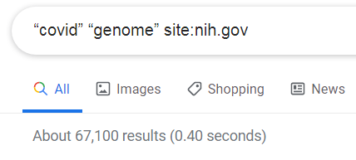
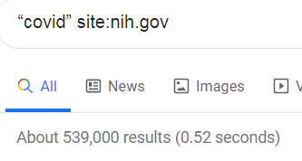

World “covid”
All Countries
All People
All Searchers
Models Measurements
Datas Tools Algorithms
Instruments Detectors
Datastreams
Searchers
“covid”
Searchers
Searchers
“covid” “genome”

